Slide 1
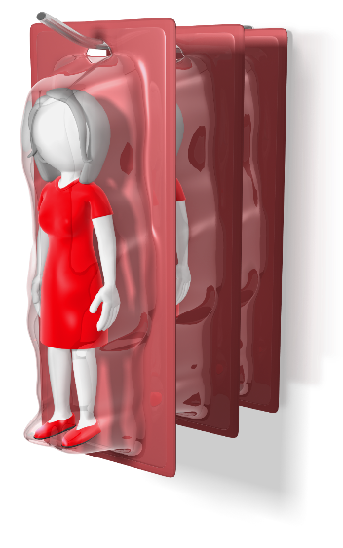
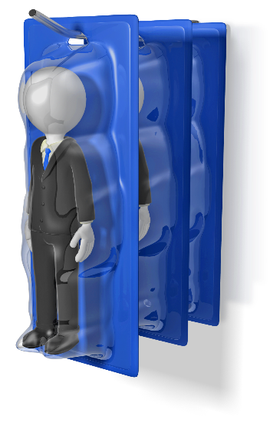
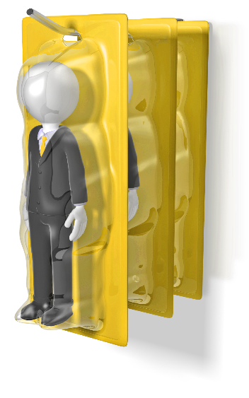
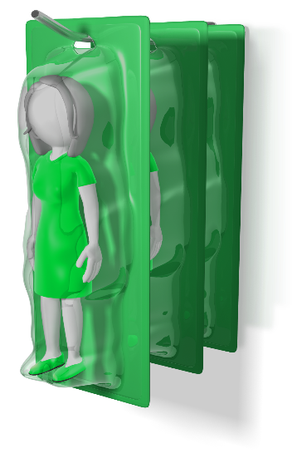
Insight Edge
The Art of Understanding People…
Made Easy!

Slide 2
Four Goals for Today
To understand your behavioral tendencies and how they affect others
To understand, respect, appreciate, and value the people you lead, work with, and spend time around every day
To develop strategies for working together to increase productivity and proper communication
To enhance your effectiveness in completing tasks by improving your relationships with others

Slide 3
Effective Communicators
Have positive attitudes as they look for opportunities to serve in the best interests of others and the situations they face
Know how to maximize what they do well
Know how to adapt their behavior in every situation

Slide 4
Which is More Important in Communication?
Reality or Perception

Slide 6
What do you see?

Slide 7
The Influence of Style
What are the different behavioral styles?
What is my style?
How do styles influence relationships?

Slide 8
Report Cover – Your Style
Personal Assessment for:
John Smith - Primary/Secondary
This assessment was completed on January 1, 20XX

Slide 9
Page 3 – Your Pattern
How You See Yourself
How You Are Perceived
How You Act at Work

Slide 10
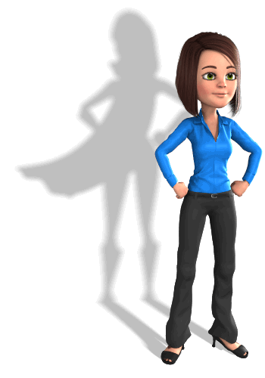
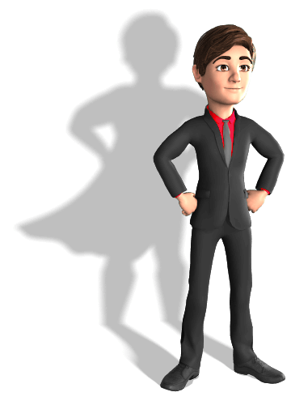
Page 5 – The Four Styles
Dominant
Expressive
Analytical
Amiable

Slide 11
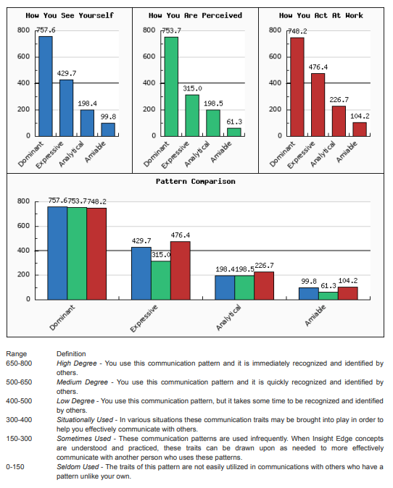
Page 6 - Graphs

Slide 12
Your Personal Assessment
Pages 7 and 8 – How You See Yourself
Cross out anything you don’t agree with
Pages 9 and 10 – How Others See You
Circle anything you don’t agree with
Pages 11 and 12 – Your Behavior at Work
Circle anything you don’t agree with

Slide 13
Your Personal Assessment
Pages 13 and 14 – How You May Need to Adapt
Choose one or two things that you agree with
Pages 15 and 16 (or 17) – Being More Effective
Choose one thing to work on for the next 30 days

Slide 14
Page 30 - Overview
It’s OK to be a(n): Write your style here
The Personal Assessment measures your patterns of communication in three areas: how you see yourself, how others see you, and your behavior at work or under pressure
The Personal Assessment describes your patterns of communication only. It is not meant to be predictive of: your intelligence; your value; your skills or experience; your education or training; your horoscope; your birth order; your culture; your monetary status; your environment; left or right brain; your potential; your upbringing; your competence

Slide 15
Page 30 - Overview
The four major patterns of communication are: Dominant, Expressive, Analytical, and Amiable
According to our studies, the percentage breakdown for the primary pattern of individuals generally occur as follows:
Dominant – 12%
Expressive – 19%
Analytical – 32%
Amiable – 37%

Slide 16
Page 30 - Overview
The patterns that differ most from each other are:
Dominant and Amiable
Expressive and Analytical
The best pattern of communication to use most frequently is: your own!

Slide 17
Page 31 – Word Exercise
This exercise clarifies two points:
We all have the ability to exhibit the behaviors and characteristics of all four styles
You will probably favor two of the four patterns of communication and use them 90-95% of the time

Slide 18
Page 32 – The Pattern Model
- Responsiveness +
Outgoing / Tell / Fast Loud / Decisive / Assertive
Dominant
Expressive
P E O P L E
T
A
S
K
+ Assertiveness -
Analytical
Amiable
Reserved / Ask / Moderate Quieter / Courteous / Accommodating

Slide 19
Page 32 – The Pattern Model
- Responsiveness +
Outgoing / Tell / Fast Loud / Decisive / Assertive
Dominant
Expressive
P E O P L E
T
A
S
K
+ Assertiveness -
Analytical
Amiable
Reserved / Ask / Moderate Quieter / Courteous / Accommodating

Slide 20
Page 32 – The Pattern Model
- Responsiveness +
Outgoing / Tell / Fast Loud / Decisive / Assertive
Dominant
Expressive
P E O P L E
T
A
S
K
+ Assertiveness -
Analytical
Amiable
Reserved / Ask / Moderate Quieter / Courteous / Accommodating

Slide 21
Page 32 – The Pattern Model
- Responsiveness +
Outgoing / Tell / Fast Loud / Decisive / Assertive
Dominant
Expressive
P E O P L E
T
A
S
K
+ Assertiveness -
Analytical
Amiable
Reserved / Ask / Moderate Quieter / Courteous / Accommodating

Slide 22
Page 32 – The Pattern Model
- Responsiveness +
Outgoing / Tell / Fast Loud / Decisive / Assertive
Dominant
Expressive
P E O P L E
T
A
S
K
+ Assertiveness -
Analytical
Amiable
Reserved / Ask / Moderate Quieter / Courteous / Accommodating

Slide 23
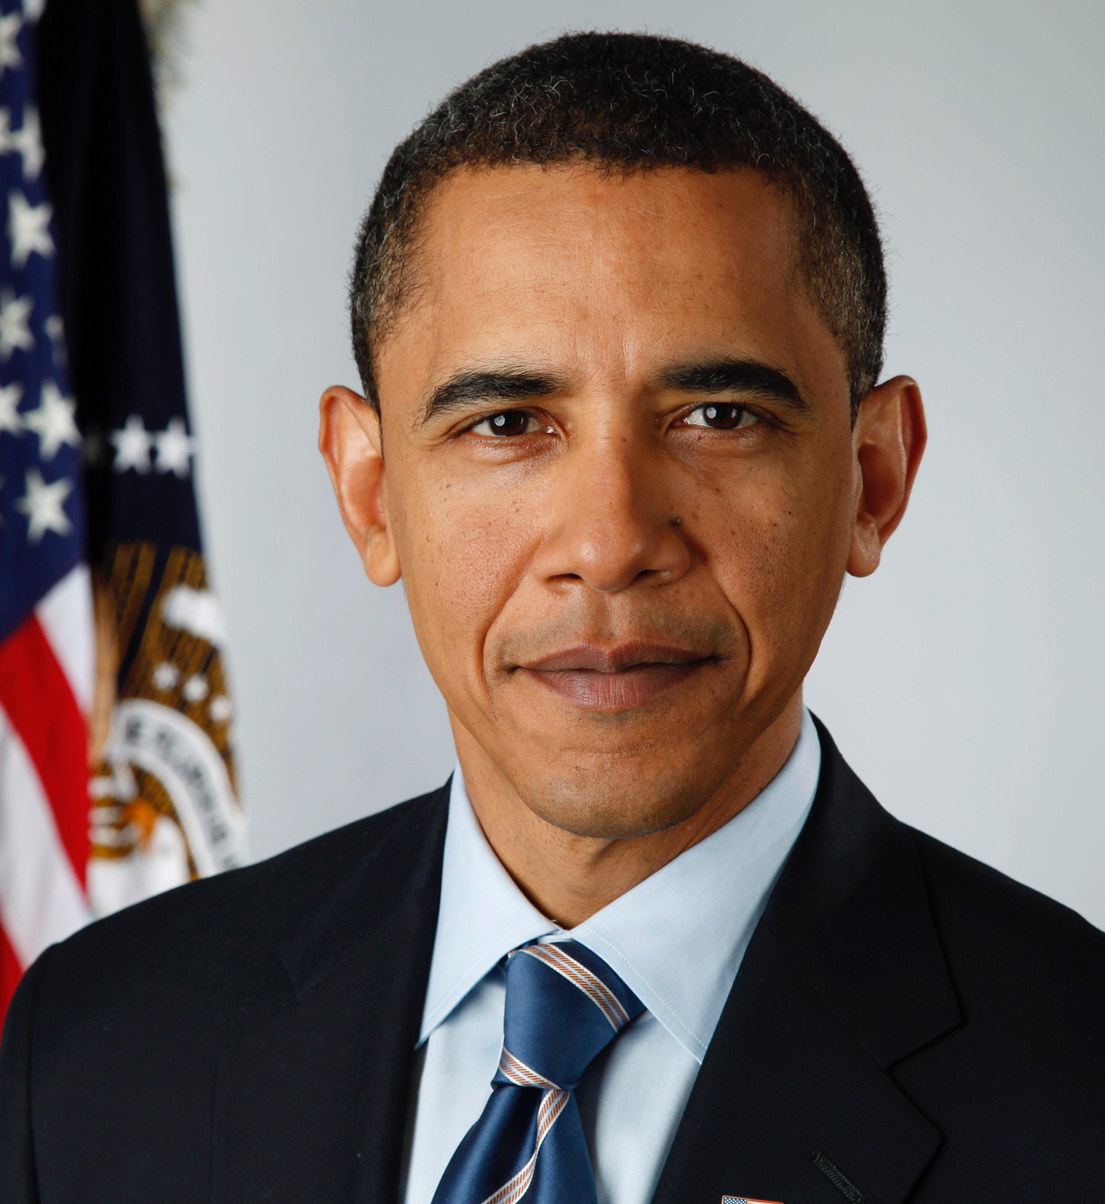
Page 33 – Dominants Act Like
Barack
Obama
Donald Trump
Hillary Clinton
Kevin O’Leary
12%; Task/Accomplishment; The Finger; The List;
2 Minute Conversations; Quick Decisions; Eye to Eye; Tell;
Now; Never Wrong; Build Respect through Common Ground

Slide 24
Page 34 – Recognize the Dominant
High Assertiveness
Quickly
Space
“Pay Attention”
Eye Contact
To the Point

Slide 25
Page 34 – Recognize the Dominant
Low Responsiveness
Little
Limited
Direct
Non-Interested
Small Talk

Slide 26
Page 35 - When Working with Dominants
Take them seriously, not personally
Start with the bottom line and allow them to maintain control

Slide 27
Page 35 – Dominants, When Working With Others
Ask more, tell less
Be careful about eye contact and personal space

Slide 28
Page 35 – Positive Perceptions
Decisive
Fair
Efficient
Determined

Slide 29
Page 35 – Negative Perceptions
Pushy/Uncaring
Severe/Harsh
Tough-Minded
Dominating

Slide 30
You Know You’re a Dominant When…
You are walking around the lake and decide to walk across it for a change

Slide 31
You Know You’re a Dominant When…
You feel the urge to direct traffic at 5:00 PM

Slide 32
You Know You’re a Dominant When…
You reminisce about the good old days when it was legal to duel with guns to settle arguments

Slide 33
You Know You’re a Dominant When…
You arrive at work at 8:00 AM and by 8:03 no one is speaking with you

Slide 34
Page 37 – Expressives Act Like
Jim Carrey
Jay Leno
Julia Roberts
Eddie Murphy
19%; Touch; Center Stage; Smile; Animated;
Overcommit; Big Picture vs. Details to Get There;
Look Good; Roller Coaster

Slide 35
Page 38 – Recognize the Expressive
High Assertiveness
Faster
Unlimited Energy
Emotion
Quickly
Pressure

Slide 36
Page 38 – Recognize the Expressive
High Responsiveness
Broad Range
Playful
Wander From
Disclose
Opinions

Slide 37
Page 39 – When Working with Expressives
Paraphrase and playback agreements and understandings
Give them the big picture first

Slide 38
Page 39 – Expressives, When Working with Others
Tell others when you are thinking out loud
Back up and restate commitments after confirming information and time frames

Slide 39
Page 39 – Positive Perceptions
Gregarious
Spontaneous
Stimulating / Persuasive
Enthusiastic / Fun Loving

Slide 40
Page 39 – Negative Perceptions
Manipulative / Dishonest
Undisciplined / Undependable
Reactive
Self-promotional

Slide 41
You Know You’re An Expressive When…
You leave a voice mail message and need to call four times to leave the entire message

Slide 42
You Know You’re An Expressive When…
You offer to help an elderly woman across the street when she is sitting on her front porch with no intention of moving

Slide 43
You Know You’re An Expressive When…
You dial a wrong number and talk to the person for half an hour anyway

Slide 44
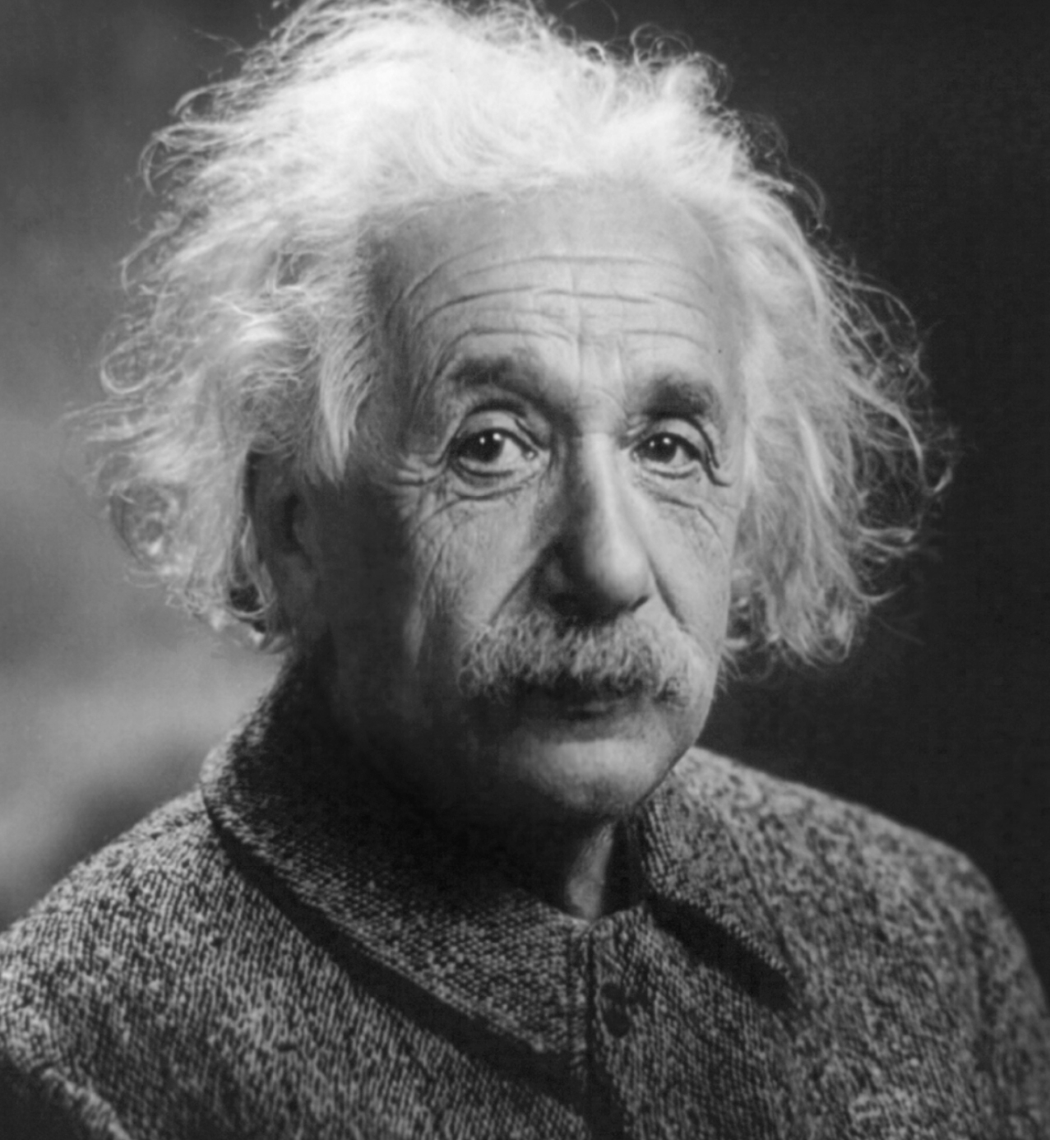
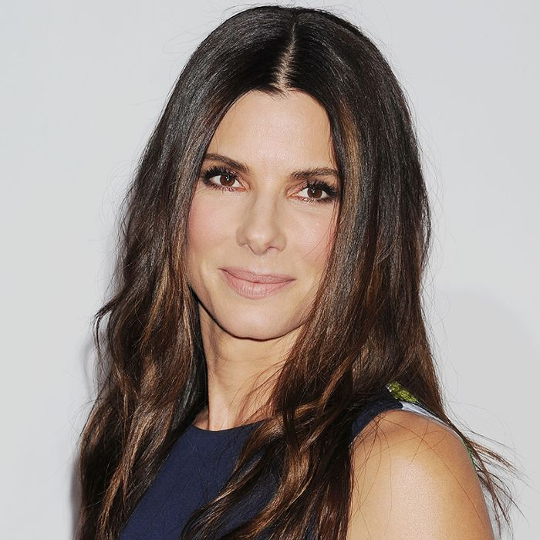
Page 41 – Analyticals Act Like
Albert Einstein
Mister Spock
Sandra Bullock
George W. Bush
32%; A to Z; High Value/Quality; Right the First Time;
Attentive to Detail; Processes; Facts; 3 to 5 Seconds; “The Look”

Slide 45
Page 42 – Recognize the Analytical
Low Assertiveness
Comfortable
Ask Questions
Appear
Quality
Rushed

Slide 46
Page 42 – Recognize the Analytical
Low Responsiveness
Facial Expression
Impression
Creative
Left Alone
Critical

Slide 47
Page 43 – When Working with Analyticals
Allow them 3-5 seconds to respond
Ask for and answer with specific information

Slide 48
Page 43 – Analyticals, When Working with Others
Tell others when you need time to think
Prioritize “the list”: A items must be done today; B items can wait

Slide 49
Page 43 – Positive Perceptions
Orderly
Thorough/Patient
Accurate/Vigilant
Industrious

Slide 50
Page 43 – Negative Perceptions
Critical
Moralistic
Unresponsive/Slow
Stuffy/Indecisive

Slide 51
You Know You’re an Analytical When…
You begin your summer vacation by reading all your insurance policies

Slide 52
You Know You’re an Analytical When…
You make a hobby out of checking the claims of laundry detergents

Slide 53
You Know You’re an Analytical When…
You run out of gas on purpose to find out exactly how far your car goes on a gallon of gas

Slide 54
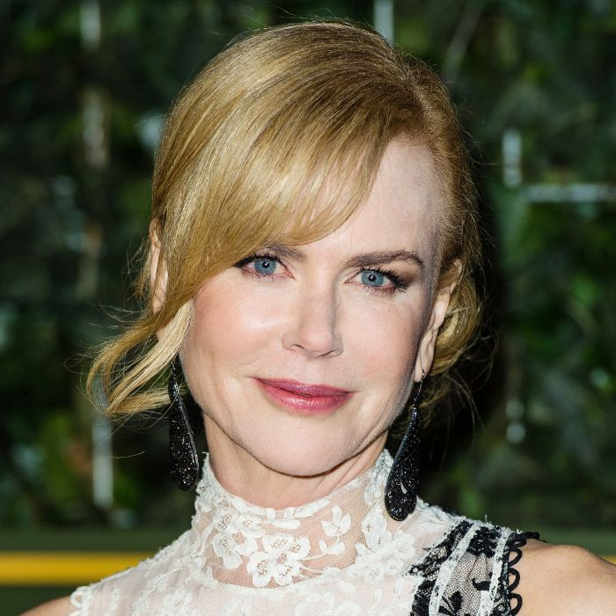
Page 45 – Amiables Act Like
Adam Sandler
George Bush
Mister Rogers
Nicole Kidman
37%; Relationship and Team Buy-In; Avoid Conflict; Peacemakers; Only Act When They Trust You;
You Never Know Where You Stand; Listen; Ask

Slide 55
Page 46 – Recognize the Amiable
Low Assertiveness
Listeners
Less-Talkative
Distance
Others
Ideas

Slide 56
Page 46 – Recognize the Amiable
High Responsiveness
Team-Oriented
Meander
Observe You
Phony
Too Quiet

Slide 57
Page 47 – When Working with Amiables
Give them time and space
Give them specifics in a softer tone of voice

Slide 58
Page 47 – Amiables, When Working with Others
Speak with more voice inflection and use a louder tone of voice
Be quicker to voice opinions

Slide 59
Page 47 – Positive Perceptions
Supportive
Patient
Loyal/Willing
Respectful / Cooperative

Slide 60
Page 47 – Negative Perceptions
Emotional
Unmotivated
Conforming
Dependent

Slide 61
You Know You’re an Amiable When…
You listen for 30 minutes to a sales call for snow removal equipment – and you live in San Diego

Slide 62
You Know You’re an Amiable When…
You are so diplomatic that when you fire someone they thank you and offer to take you out to lunch

Slide 63
How The Four Styles Arrive Late to a Meeting

Slide 64
Insight Edge
The Art of Understanding People…
Made Easy!

Slide 67
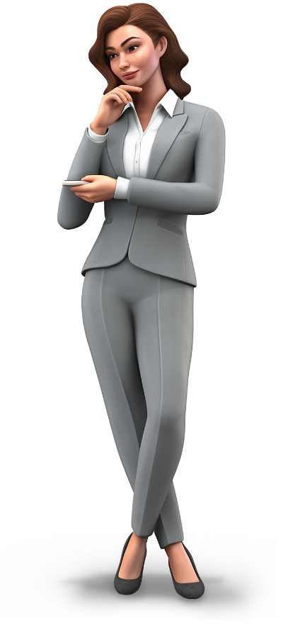
Page 30 - Your Profile is Not:
A measurement of intelligence
An indicator of someone’s value
A measurement of skills or experience
A measurement of education or training
Connected to astrology or the stars

Slide 68
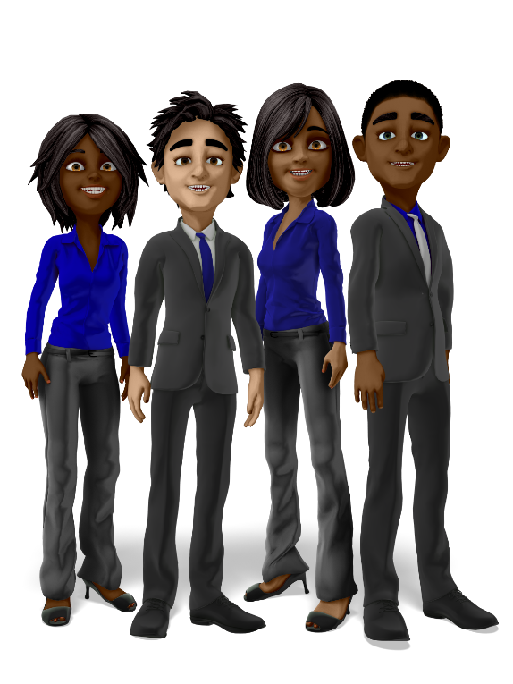
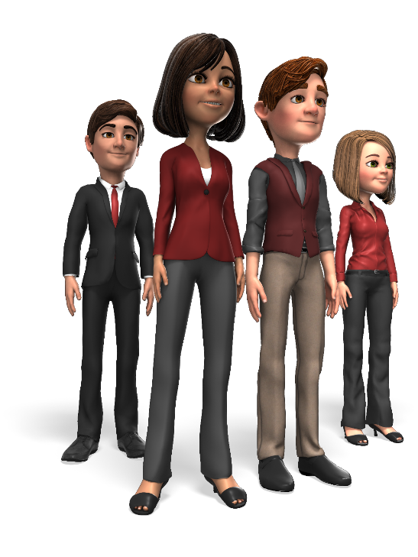
Page 30 – The Four Styles
Dominant – 12%
Expressive – 19%
Analytical – 32%
Amiable – 37%

Slide 69
Key Behavioral Style Factors
Goals: What motivates you based on your behavioral style?
Fears: What demotivates you or what conditions are you motivated to avoid?
How to be more effective: Overcome potentially limiting characteristics that can be growth opportunities
The danger of overusing strengths: A behavior that is used too often or inappropriately can be a weakness

Slide 70
Basic Motivation Concepts
You cannot motivate other people
All people are motivated
People do things for their own reasons, not yours

Slide 71
Successful Communicators
Understand how their behavior impacts others
Understand their reactions to other people
Know how to maximize on what they do well
Convey a positive attitude about themselves which causes others to have confidence in them
Know how to adapt their behavior to meet the needs of other people and situations

Slide 72
Good to Great
“Good is the enemy of great.”
Opening line in the book Good to Great by Jim Collins

Slide 73
One Thought
The reason why there is an epidemic of poor communication is because many people are not willing to pay the price of consistently communicating in a way that respects others.

Slide 74
The Dominant Perspective:
High ego
Goal oriented
Motivated by challenges
Basic fear - being taken advantage of or loss of control
Under pressure - may show lack of concern for others’ views or feelings

Slide 75
Page 36 – Dominant Review
What climate or atmosphere should be established when interacting with a Dominant?
What are a Dominant’s priorities regarding use of time?
At what pace is a Dominant most comfortable?
In what form do Dominants like information?
How can you win acceptance from a Dominant?

Slide 76
Page 36 – Dominant Review
How can you instruct a Dominant in accomplishing a task?
What kind of support will a Dominant require from you?
How does a Dominant make a decision?
The next time you work or speak with an individual using a Dominant pattern, what are three behaviors you can use that will put the two of you on the same wavelength?

Slide 77
The Expressive Perspective
Optimistic
People oriented
Motivated by social recognition
Basic fear - social rejections
Under pressure - can become disorganized

Slide 78
Page 40 – Expressive Review
What climate or atmosphere should be established when interacting with an Expressive?
What are an Expressive’s priorities regarding use of time?
At what pace is an Expressive most comfortable?
In what form do Expressives like information?
How can you win acceptance from an Expressive?

Slide 79
Page 40 – Expressive Review
How can you instruct an Expressive in accomplishing a task?
What kind of support will an Expressive require from you?
How does an Expressive make a decision?
The next time you work or speak with an individual using an Expressive pattern, what are three behaviors you can use that will put the two of you on the same wavelength?

Slide 80
The Analytical Perspective
Attention to details
Goal oriented - tasks
Motivated by correctness and quality
Basic fear - criticism of their work
Under pressure - can become overly critical of self and others

Slide 81
Page 44 – Analytical Review
What climate or atmosphere should be established when interacting with an Analytical?
What are an Analytical’s priorities regarding use of time?
At what pace is an Analytical most comfortable?
In what form do Analyticals like information?
How can you win acceptance from an Analytical?

Slide 82
Page 44 – Analytical Review
How can you instruct an Analytical in accomplishing a task?
What kind of support will an Analytical require from you?
How does an Analytical make a decision?
The next time you work or speak with an individual using an Analytical pattern, what are three behaviors you can use that will put the two of you on the same wavelength?

Slide 83
The Amiable Perspective
Consistent performance
Goal oriented - team
Motivated by maintenance of status quo
Basic fear - loss of stability/change
Under pressure - can become overly willing to give up

Slide 84
Page 48 – Amiable Review
What climate or atmosphere should be established when interacting with an Amiable?
What are an Amiable’s priorities regarding use of time?
At what pace is an Amiable most comfortable?
In what form do Amiables like information?
How can you win acceptance from an Amiable?

Slide 85
Page 48 – Amiable Review
How can you instruct an Amiable in accomplishing a task?
What kind of support will an Amiable require from you?
How does an Amiable make a decision?
The next time you work or speak with an individual using an Amiable pattern, what are three behaviors you can use that will put the two of you on the same wavelength?

